Slide 1
INTRUSION DETECTION SYSTEM REVIEW 2

Slide 2


CONTENTS OF THIS REVIEW
PROBABILISTIC MODEL
a) GAUSSIAN MIXTURE MODEL
b) NAIVE BAYES CLASSIFIER MODEL
c) HIDDEN MARKOV MODEL
2. UNSUPERVISED MODEL
a) K-MEANS CLUSTERING MODEL
b) DB-SCAN MODEL
c) HIERARCHICAL CLUSTERING
3. DIMENSIONAL REDUCTION
a) PCA (Principal Component Analysis)
b) t-SNE (t-distributed Stochastic Neighbour Embedding) MODEL
4. ENSEMBLE MODEL
a) RANDOM FOREST
b) GRADIENT BOOSTING MODEL

Slide 3
WHAT DO WE DO?
SNO | NAME OF THE STUDENT | CONTRIBUTION | ROLL NUMBER
1 | M MEHER VARDHAN | PPT, GMM, NAVIE BAYES | 21034
2 | M SRIKAR | PCA, T-SNE, PPT | 21038
3 | N.G.KRISHNA REDDY | COMPARISONS, DB-SCAN, HIERARCHIAL | 21039
4 | KRISHNA NERELLA | PPT, HMM, K-MEAN CLUSTERING | 21040
5 | T HARSHA VARDHAN | COMPARISONS, RANDOM FOREST, XGB | 21062

Slide 4


WHY ML IN IDS
Machine Learning in Intrusion Detection Systems enhances security by learning normal patterns and detecting anomalies, adapting to evolving threats, and reducing false positives through behavioral analysis, enabling efficient identification of complex attack patterns.

Slide 5
OUR MODELS IN REVIEW 2
PROBABILISTIC MODEL
UNSUPERVISED
MODEL
DIMENSIONAL REDUCTION
ENSEMBLE MODEL
Unsupervised learning lets machines discover hidden patterns in unlabeled data, like grouping similar items together or finding anomalies. It's like exploring a new world and uncovering its secrets without a map.
Dimensional reduction squeezes high-dimensional data into fewer dimensions, preserving important information. Think of it like compressing a complex image into a smaller file with minimal detail loss.
Ensemble models in machine learning blend predictions from multiple models for improved accuracy. Examples include Random Forests and Gradient Boosting, enhancing performance through collaborative learning.
Probabilistic models in machine learning assess uncertainty by assigning probabilities to different outcomes. Examples include Gaussian Mixture Models and Naive Bayes, employed for tasks like classification and regression.

Slide 6
01
PROBABILISTIC MODEL

Slide 7
PROBABILISTIC MODEL
GAUSSIAN MIXTURE MODEL | NAIVE BAYES CLASSIFIER MODEL | HIDDEN MARKOV MODEL
A Gaussian Mixture Model (GMM) is a statistical model that expresses a dataset as a mix of Gaussian distributions, enabling it to identify patterns and clusters. It estimates parameters like means and covariances using the Expectation-Maximization algorithm, making it useful in machine learning for tasks like clustering and density estimation.
Naive Bayes classifier is a probabilistic machine learning model based on Bayes' theorem. It assumes independence between features and is particularly efficient for text classification and spam filtering.
Hidden Markov Models (HMMs) are statistical models that represent a system with hidden states, observed through a sequence of observable outputs. Widely used in machine learning, HMMs are employed for tasks like speech recognition, bioinformatics, and natural language processing.

Slide 8
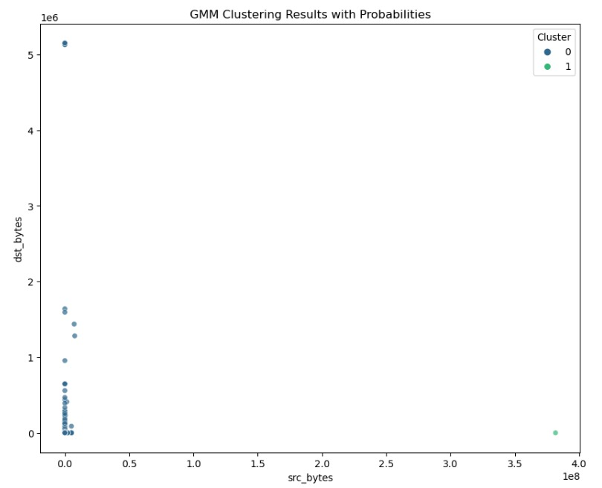
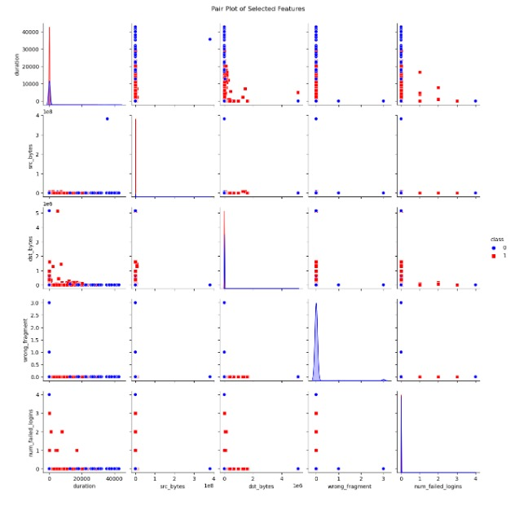
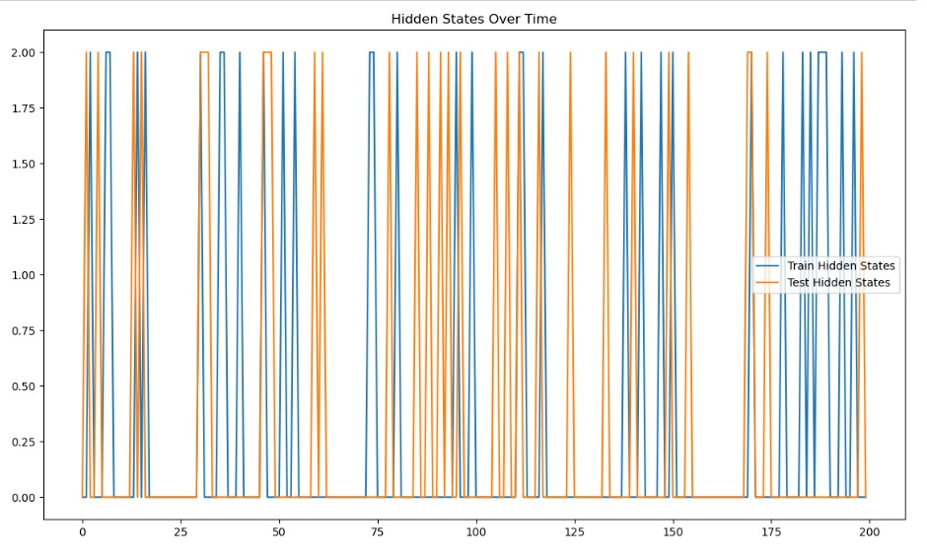
VISUALISATION OF PROBABILISTIC MODEL
HIDDEN MARKOV MODEL
GAUSSIAN MIXTURE MODEL
NAIVE BAYES CLASSIFIER MODEL

Slide 9
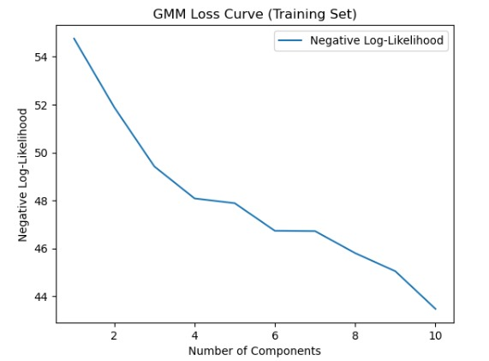
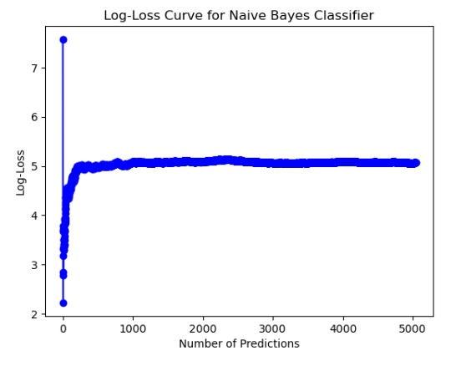
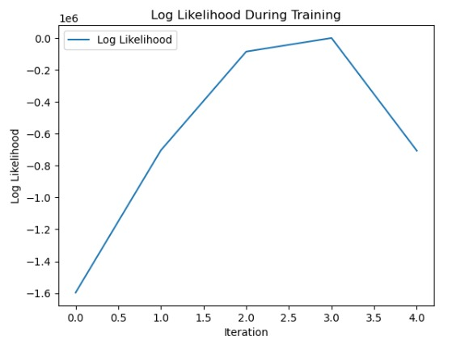
LOSS CURVES OF PROBABILISTIC MODEL
GAUSSIAN MIXTURE MODEL
NAIVE BAYES CLASSIFIER MODEL
HIDDEN MARKOV MODEL

Slide 10
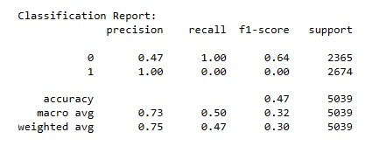
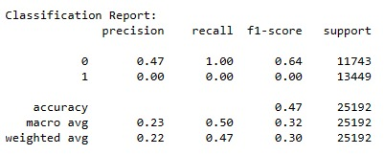
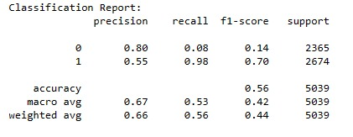
CLASSIFICATION REPORTS OF PROBABILISTIC MODEL
GAUSSIAN MIXTURE MODEL
HIDDEN MARKOV MODEL
NAIVE BAYES CLASSIFIER MODEL

Slide 11
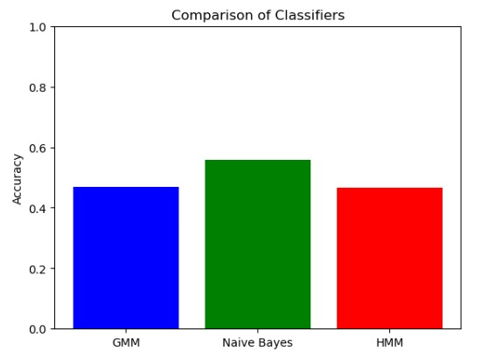
STATISTICS OF ALL THE THREE MODELS IN PROBABILISTIC MODEL
The best probabilistic model for our dataset is Naive Bayes, as it exhibits significantly higher accuracy when compared with Gaussian Mixture Models (GMM) and Hidden Markov Models (HMM).

Slide 12
02
UNSUPERVISED MODEL

Slide 13
UNSUPERVISED MODEL
K-MEANS CLUSTERING MODEL | DB-SCAN MODEL | HIERARCHICAL CLUSTERING
DBSCAN (Density-Based Spatial Clustering of Applications with Noise) is a density-based clustering algorithm that identifies clusters as dense regions separated by sparser areas, effectively handling irregularly shaped clusters and noise in the data.
Hierarchical clustering is an agglomerative or divisive approach that organizes data into a tree-like hierarchy of clusters, allowing for a flexible exploration of relationships at different levels of granularity within the dataset.
K-means clustering is a partitioning algorithm that groups data points into k distinct, non-overlapping subgroups based on their feature similarities, aiming to minimize the within-cluster variance.

Slide 14
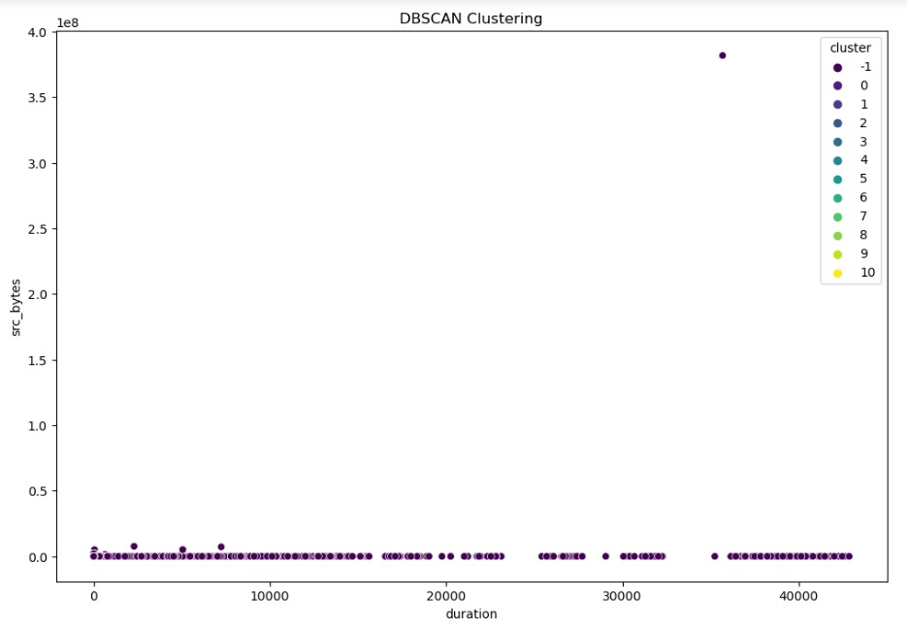
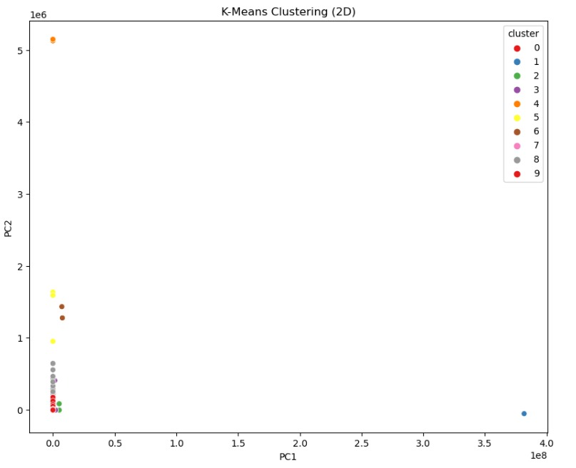
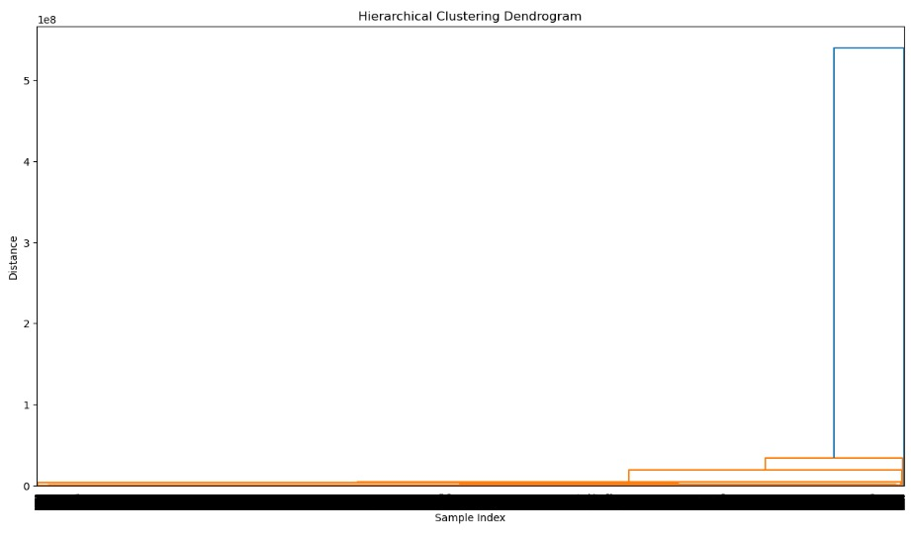
VISUALISATION OF UNSUPERVISED LEARNING
HIERARCHICAL CLUSTERING
K-MEANS CLUSTERING MODEL
DB-SCAN MODEL

Slide 15
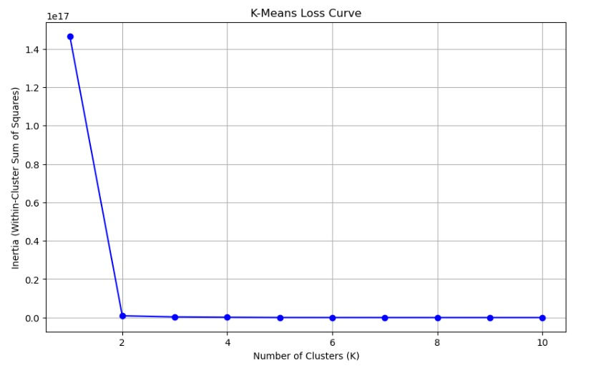
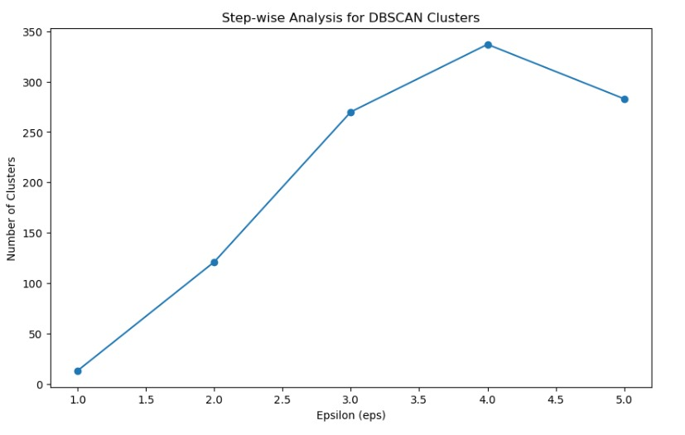
LOSS CURVES
UNSUPERVISED LEARNING
K-MEANS CLUSTERING MODEL
DB-SCAN MODEL

Slide 16
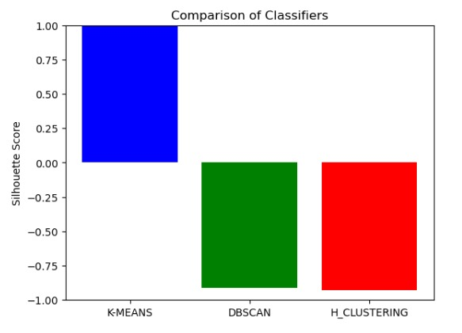
COMPARISON IN THREE MODELS OF
UNSUPERVISED LEARNING
The best unsupervised learning model for our dataset is
K-MEANS, as it exhibits significantly higher Silhouette Score when compared with DBSCAN and Hirarical clustering.

Slide 17
03
DIMENSIONALITY REDUCTION

Slide 18
DIMENSIONALITY REDUCTION
PCA (Principal Component Analysis) | t-SNE (t-distributed Stochastic Neighbour Embedding) MODEL
PCA (Principal Component Analysis) is a dimensionality reduction technique that transforms high-dimensional data into a lower-dimensional space while preserving as much variance as possible. | t-SNE (t-Distributed Stochastic Neighbor Embedding) is a dimensionality reduction technique in machine learning that visualizes high-dimensional data by preserving local similarities, effectively mapping complex relationships into a lower-dimensional space. It is particularly useful for exploring and understanding patterns in data clusters, revealing hidden structures for improved data analysis and visualization.

Slide 19
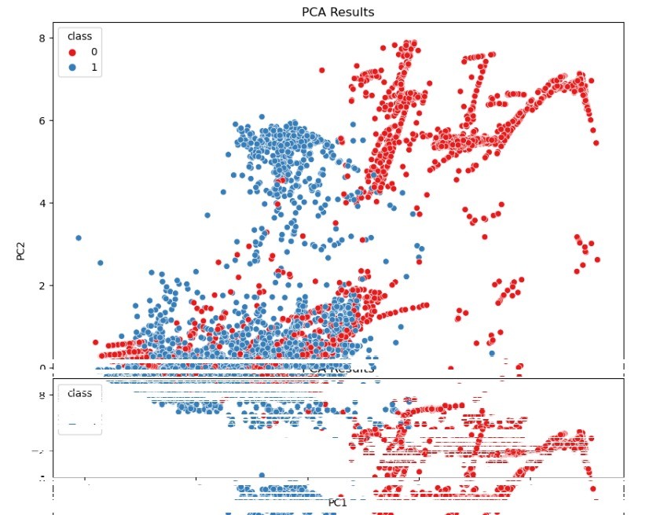
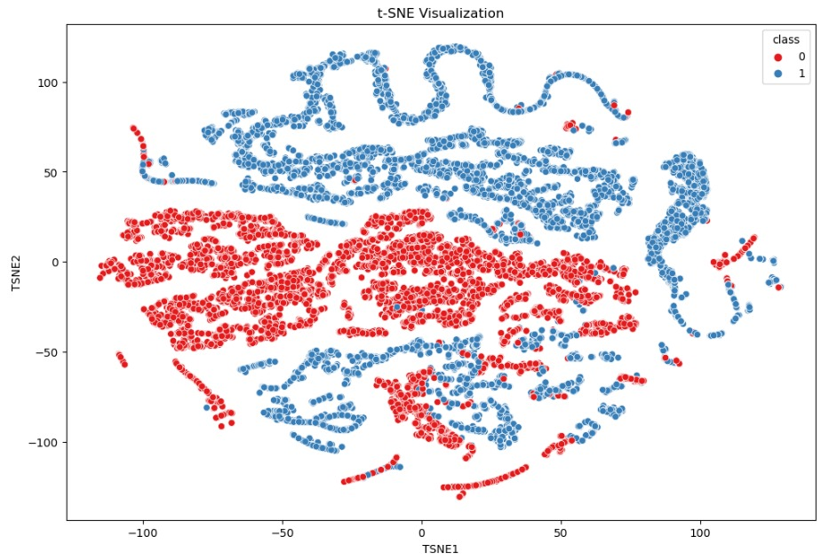
VISUALISATION OF DIMENSIONALITY REDUCTION
PCA (Principal Component Analysis)
t-SNE (t-distributed Stochastic Neighbour Embedding) MODEL

Slide 20
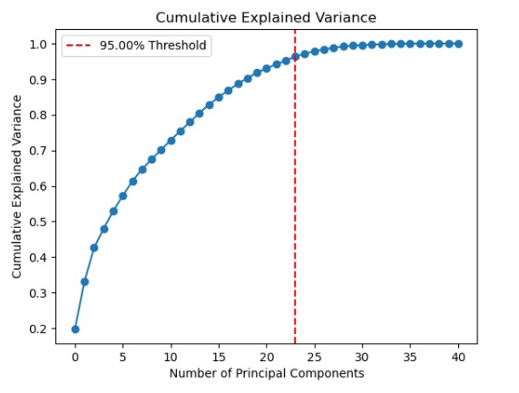
LOSS CURVES OF DIMENSIONALITY REDUCTION
PCA (Principal Component Analysis)
t-SNE (t-distributed Stochastic Neighbour Embedding) MODEL

Slide 21
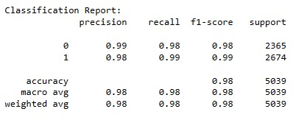
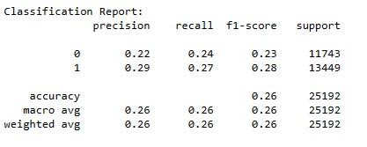
CLASSIFICATION REPORT OF DIMENSIONALITY REDUCTION
PCA (Principal Component Analysis)
t-SNE (t-distributed Stochastic Neighbour Embedding) MODEL

Slide 22
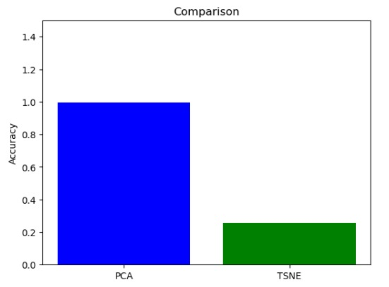
COMPARISON IN TWO MODELS OF DIMENSIONALITY REDUCTION
The best dimensionality reduction model for our dataset is PCA, as it exhibits significantly higher accuracy when compared with T-SNE

Slide 23
04
ENSEMBLE MODEL

Slide 24

ENSEMBLE MODEL
RANDOM FOREST | GRADIENT BOOSTING MODEL
Random Forest: Random Forest is an ensemble learning method that constructs a multitude of decision trees during training and outputs the mode of the classes for classification or the mean prediction for regression, providing robust and accurate predictions by mitigating overfitting and capturing diverse patterns in the data. | Gradient Boosting: Gradient Boosting is an ensemble learning technique that combines weak predictive models sequentially, with each model correcting errors of its predecessor, ultimately creating a strong predictive model with high accuracy

Slide 25
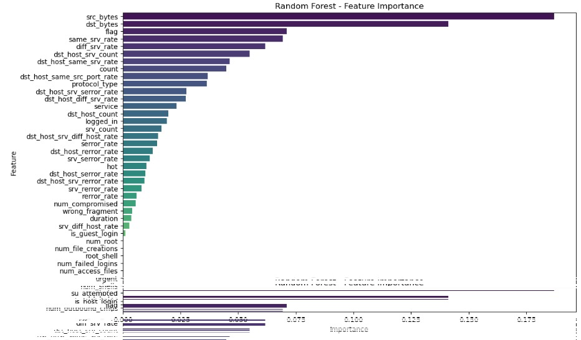
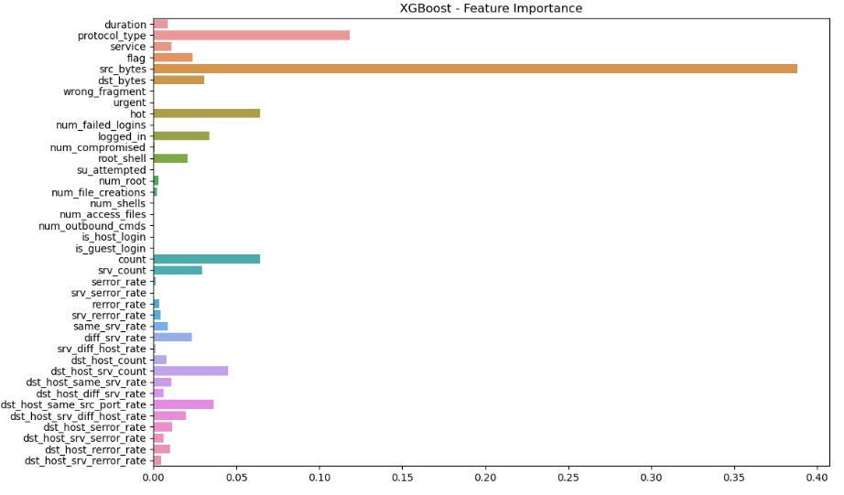

VISUALISATION OF ENSEMBLE MODEL
RANDOM FOREST
GRADIENT BOOSTING MODEL

Slide 26
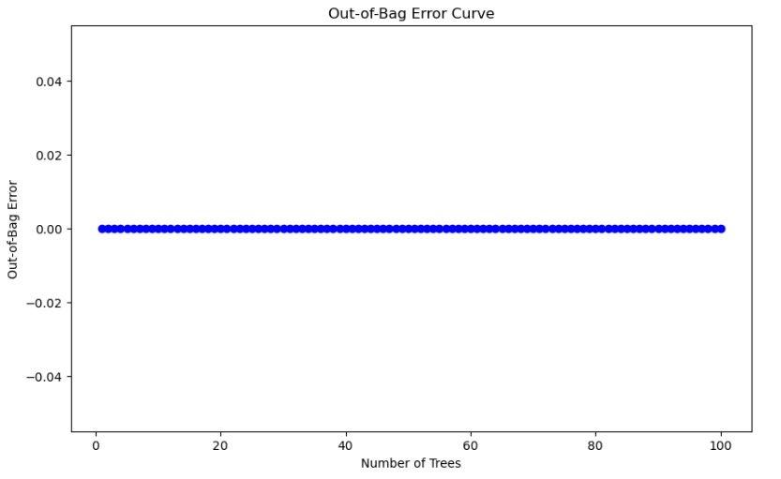
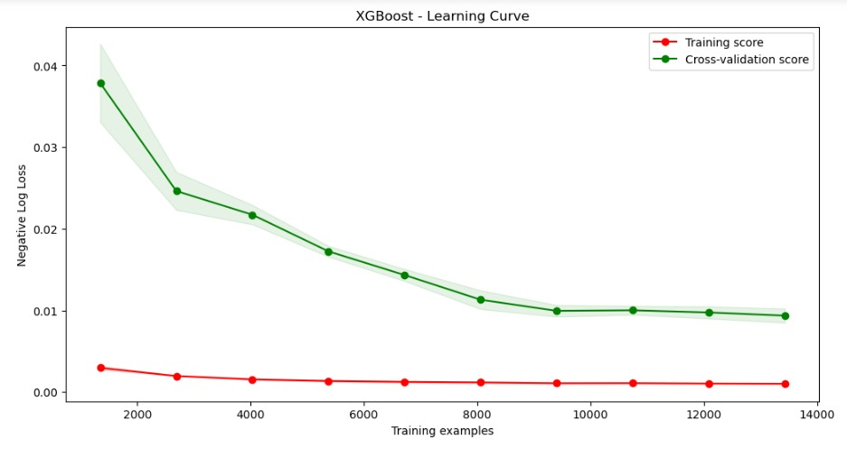
LOSS CURVES OF ENSEMBLE MODEL
RANDOM FOREST
GRADIENT BOOSTING MODEL

Slide 27
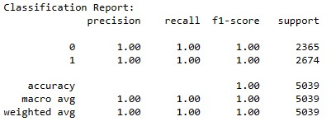
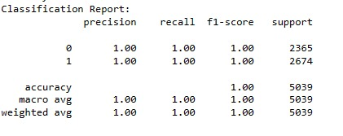
CLASSIFICATION REPORT OF ENSEMBLE MODEL
RANDOM FOREST
GRADIENT BOOSTING MODEL

Slide 28
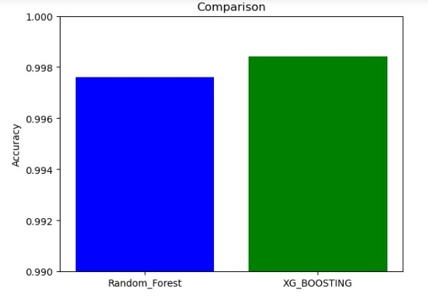
COMPARISON IN TWO MODELS IN ENSEMBLE MODEL
The best Ensemble model for our dataset is XGB BOOSTING, as it exhibits significantly higher accuracy when compared with Random Forest

Slide 29
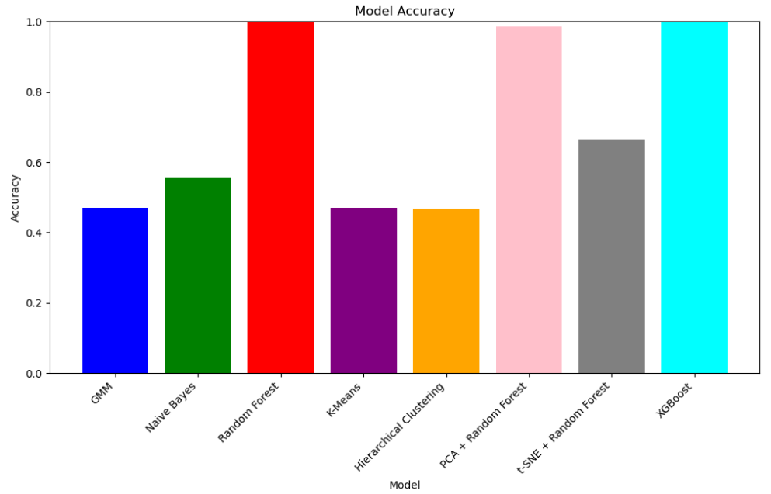
OUR FINAL STATISTICS
AS COMPARED WITH SATISTICS OF ALL MODEL WE DID SO FOR
XGB_BOOSTING HAS GIVEN A HIGH ACCURACY THAN OTHERS.SO I SAY FOR OUR IDS DATASET XGB BOOSTING IS PERFECT MODEL

Slide 30
RESOURCES
https://www.geeksforgeeks.org/intrusion-detection-system-using-machine-learning-algorithms/
https://www.paloaltonetworks.com/cyberpedia/what-is-an-intrusion-detection-system-ids
https://journalofbigdata.springeropen.com/articles/10.1186/s40537-018-0145-4
https://www.itm-conferences.org/articles/itmconf/abs/2022/06/itmconf_iceas2022_02003/itmconf_iceas2022_02003.html
https://www.kaggle.com/datasets

